Slide 1
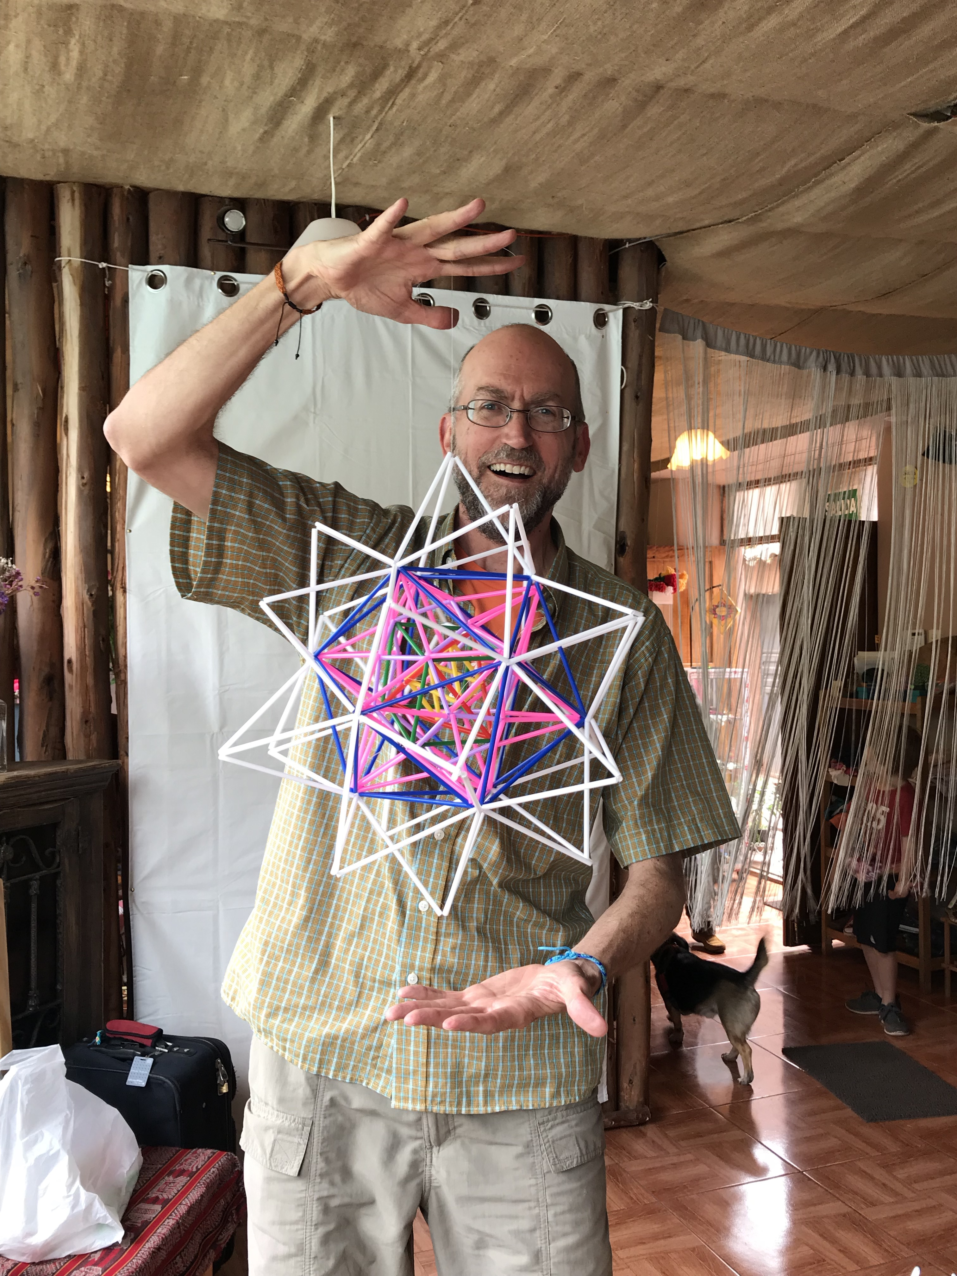
Creating and Combining Platonic Solids
By Scott Kipp

Slide 2
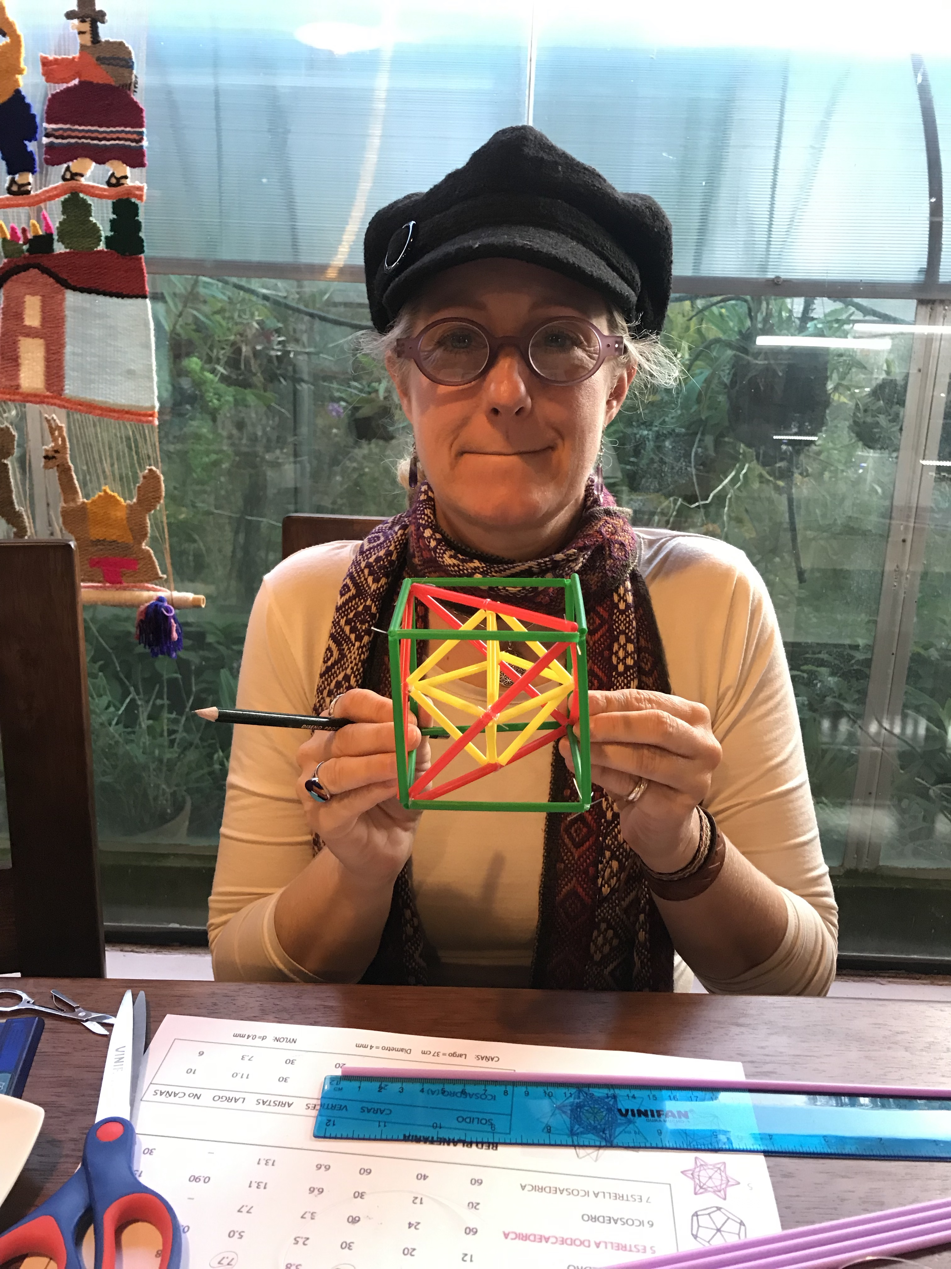
Creating Geometric Shapes
Amy and I took a class in Pisac, Peru where we made geometric shapes out of straws and fishing line
We started with simple structures or shapes and combined them into very complex shapes
Here is Amy with the first three Platonic Solids

Slide 3
https://en.wikipedia.org/wiki/Platonic_solid

Slide 4
1. Making the Tetrahedron
An tetrahedron is the first Platonic Solid and the simplest polyhedron made of four equilateral triangles
Use 12 5.0cm yellow straws starting with a triangle
4 faces, 6 edges, 4 vertices
https://en.wikipedia.org/wiki/Tetrahedron

Slide 5
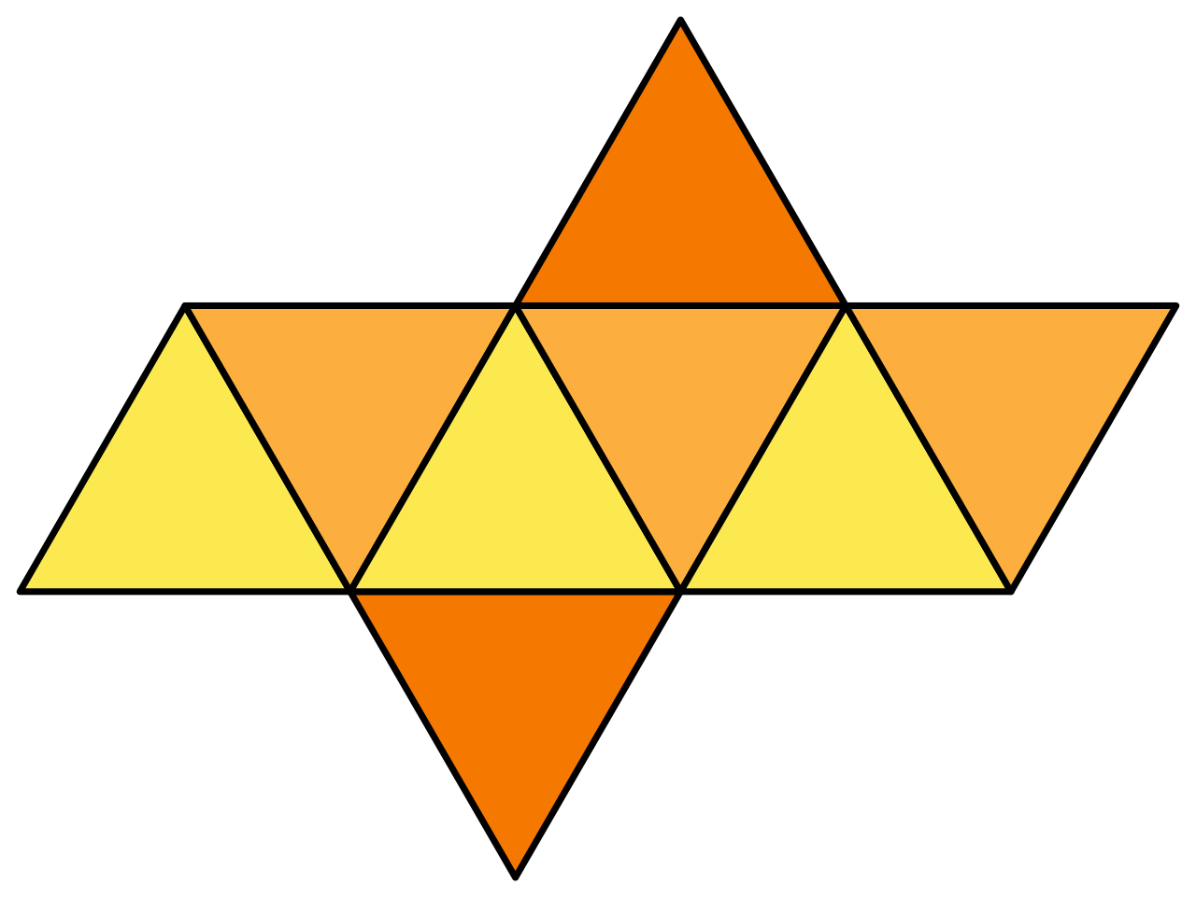
2. Making an Octahedron = 8 Sided Platonic Solid
An octahedron is a square pyramid that extends in both directions
Use 12 5.0cm yellow straws starting with a square
8 faces, 12 edges, 6 vertices
https://en.wikipedia.org/wiki/Octahedron

Slide 6
2A – Combine the Two Shapes
6 corners or vertices of the octahedron matches the 6 edges of the tetrahedron
The magic begins!
Tie the vertices of the octahedron to the straws with fishing line.

Slide 7
3. Create a Cube = 6 Sided Platonic Solid
A cube is made of six square faces
Use 12 7.7cm green straws starting with a square
6 faces, 12 edges, 8 vertices
This 2D version of the shapes is known as the net
https://en.wikipedia.org/wiki/Cube

Slide 8
3A – Combine the Third Shape
4 corners or vertices of the tetrahedron matches 4 of the 8 vertices of the cube
The magic continues!

Slide 9
4. Create a Dodecahedron = 12 Sided Platonic Solid
An dodecahedron is the fourth platonic solid made of twelve pentagons
Use 30 5.0cm purple straws starting with a pentagon
12 faces, 30 edges, 20 vertices
https://en.wikipedia.org/wiki/Regular_dodecahedron

Slide 10
4A – Combine the Fourth Shape
The 8 corners of the cube connect to 8 vertices of the dodecahedron
Be sure to insert the cube when the dodecahedron is half finished.

Slide 11
5. Create Great Icosahedron
By turning each pentagonal face of the dodecahedron into a pentagonal pyramid, we create the great icosahedron
Use 60 7.7cm pink straws on each pentagon face
60 faces
https://en.wikipedia.org/wiki/Great_icosahedron

Slide 12
6. Icosahedron = 20 Sided Platonic Solid
An icosahedron is the fifthand final platonic solid made of 20 triangles
Use 30 13.1cm blue straws starting with a triangle
20 faces, 30 edges, 12 vertices
https://en.wikipedia.org/wiki/Icosahedron

Slide 13
6a. Combine the Shapes
We’re going to put the Great Icosahedron inside a icosahedron
Connect each of the 12 vertices of the icosahedron to the 12 vertices of the great icosahedron
That’s 5 platonic solids combined!

Slide 14
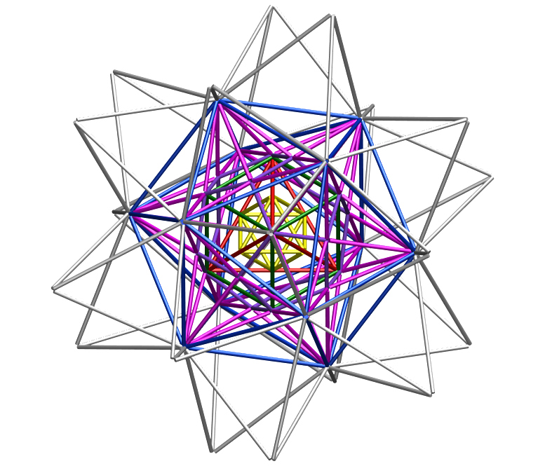
7. Create Small Triambic Icosahedron
By turning each triangular face of the icosahedron into an triangular pyramid, we create the small triambic icosahedron
Use 60 13.1cm white straws on each triangular face
60 faces, 60 edges, 40 vertices

Slide 15
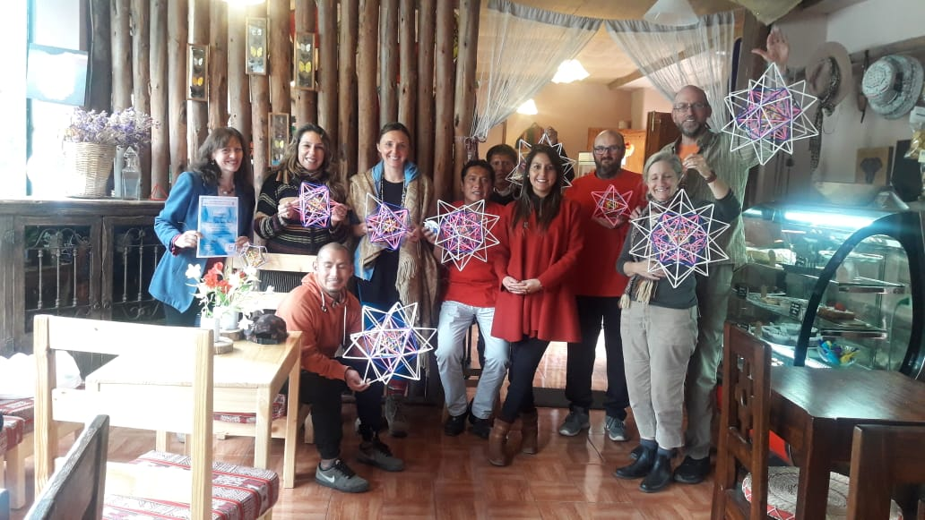
Everyone Did It!

